Slide 1


WELL-COME
ONLINE
PIZZA ORDERING SYSTEM

Slide 2


ONLINE PIZZA ORDERING
SYSTEM
Guide:-
Y.N.PATIL
SUBMITTED BY :-
Om Sonawane(2191867)(L)
Prachi Vishe(2119872)
Sakshi Prabrekar(2191858)
Kiran Kadam(2191834)

Slide 3
CONTENT
INTRODUTION
SOFTWARE REQUIRED SPECIFICATION
FRONTEND/BACKEND
PIZZA ORDER SYSTEM
IMAGE FOR OUR WEB
GUIDELINES
CONCLUSION
WEBSITE

Slide 4
INTRODUCTION
•Online Pizza ordering system is a web based application
•This is used for customers to order their pizzas online.

Slide 5
Why an Online System Needed
• This processes is easy to use.
•It will reduce the purchasing time for customers.
•As a business point of view it gives good profits.

Slide 6

Software Requirement & Specification
FRONTEND

Slide 7

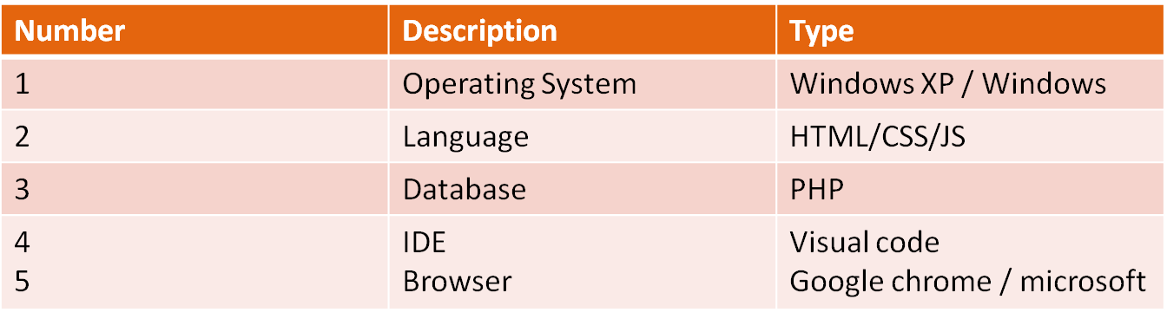
Backend:-

Slide 8
PIZZA ORDER SYSTEM
ORDERING
LOGIN/REGISTER
MENU
BUILD YOUR PIZZA
ORDERING FINAL
TRACK YOUR ORDER
ORDER PROCESSING
ADMINSTRATION
LOGOUT

Slide 9

IMAGE FOR OUR WEB APPLICATION

Slide 10
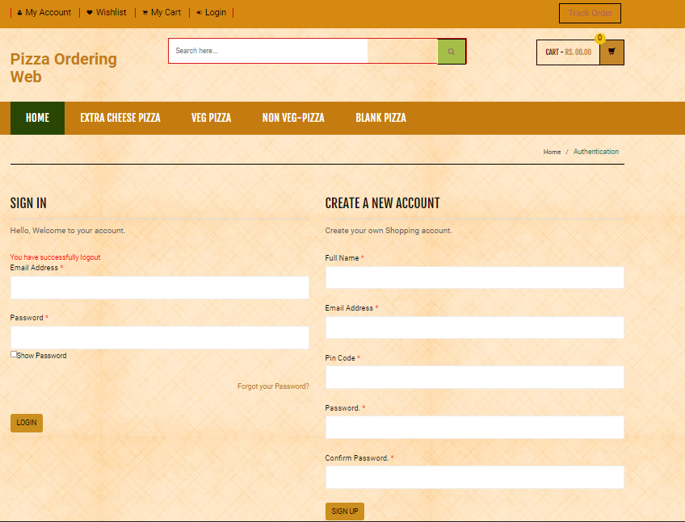
SIGN IN | SIGN UP

Slide 11
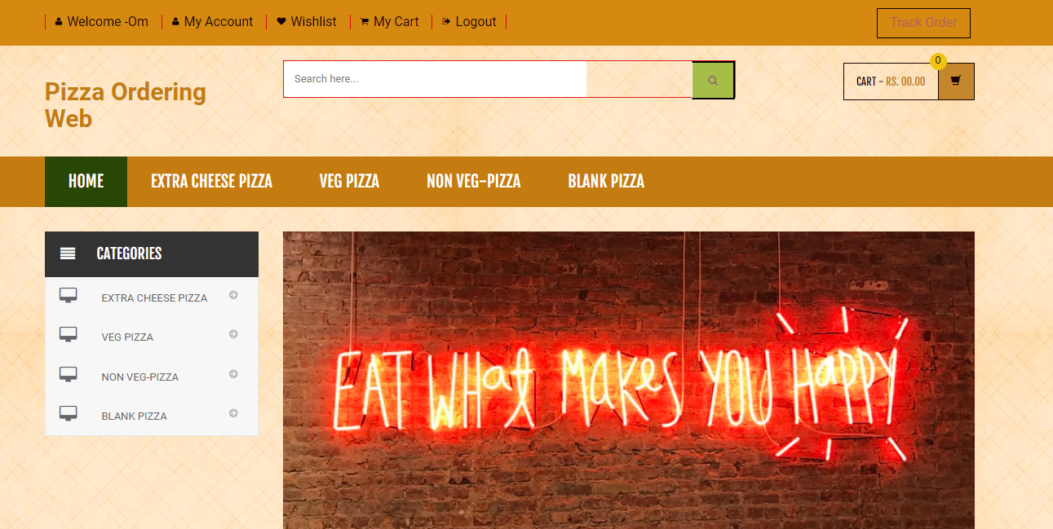
HOME PAGE

Slide 12
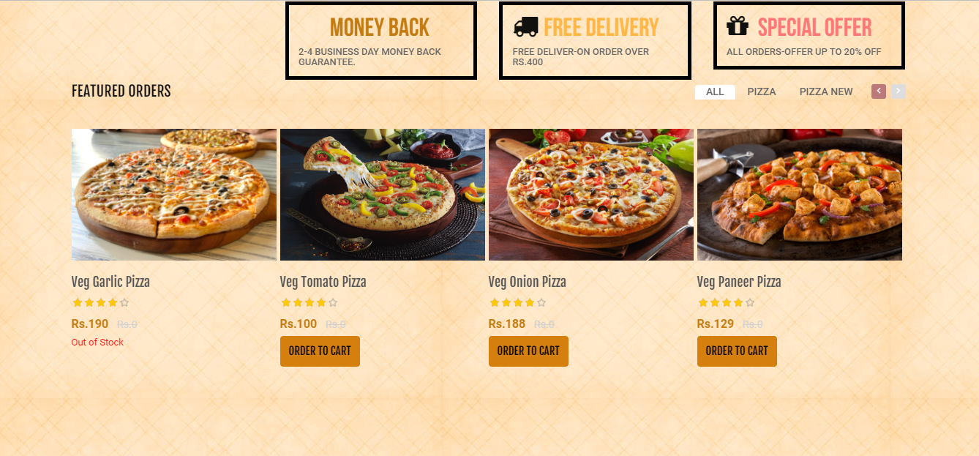
SELECT THE PIZZA

Slide 13
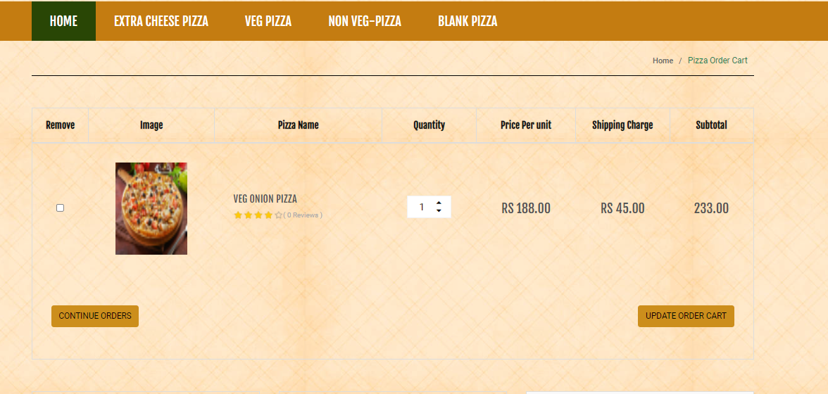
MY CART

Slide 14
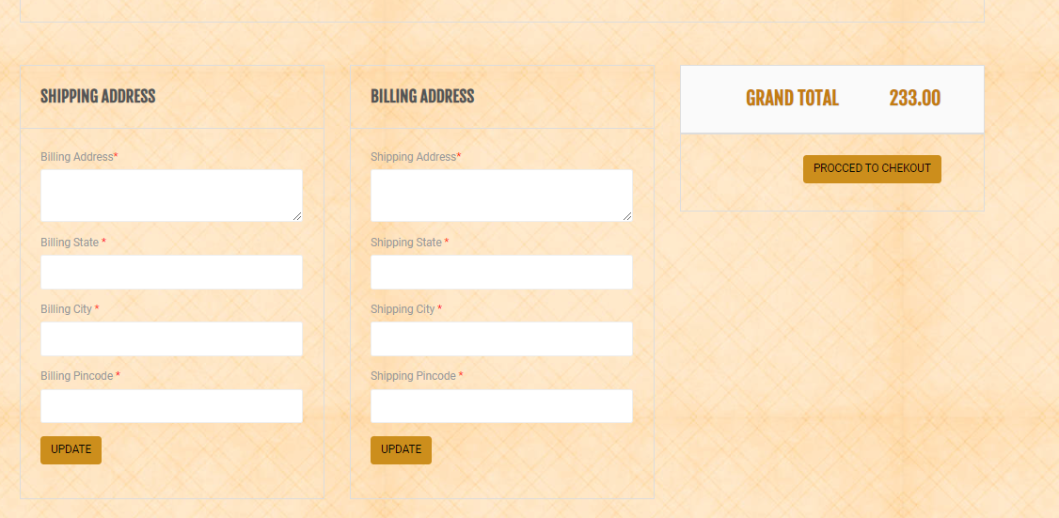
ADDRESS & CHECKOUT

Slide 15
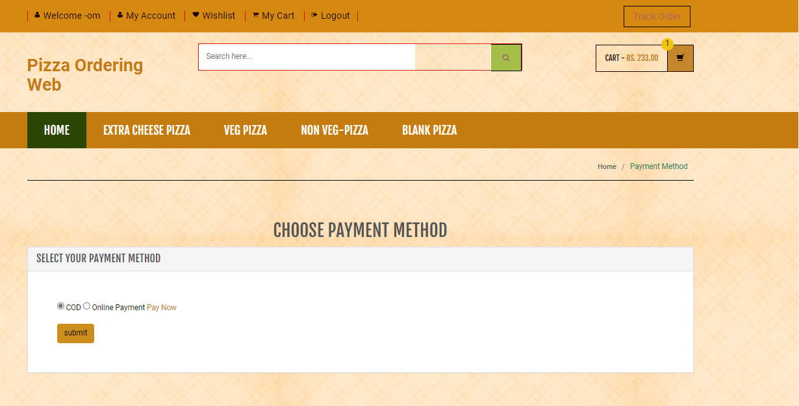
PAYMENT METHOD

Slide 16
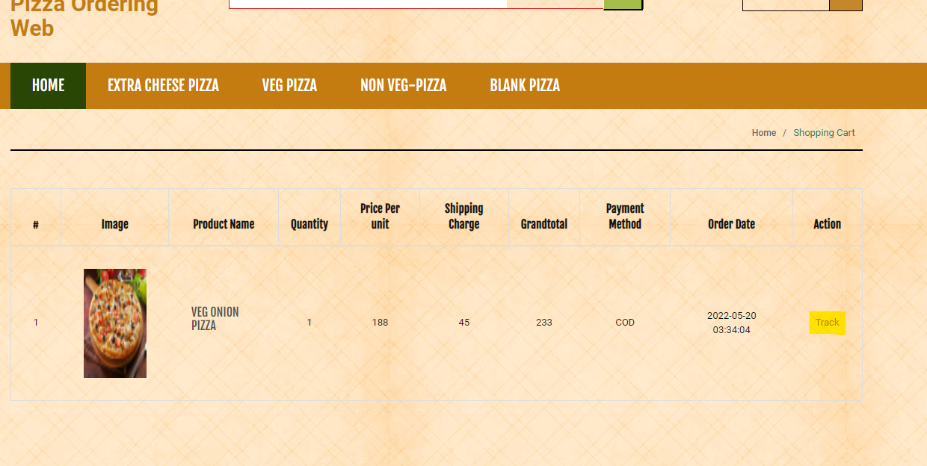
TRACKING SYSTEM

Slide 17
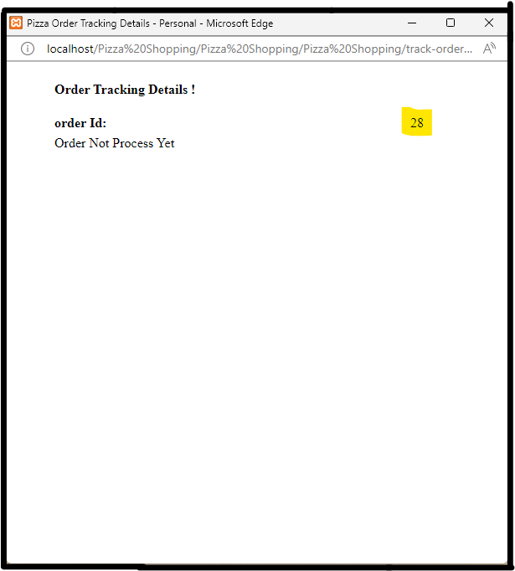
TRACK STATUS

Slide 18
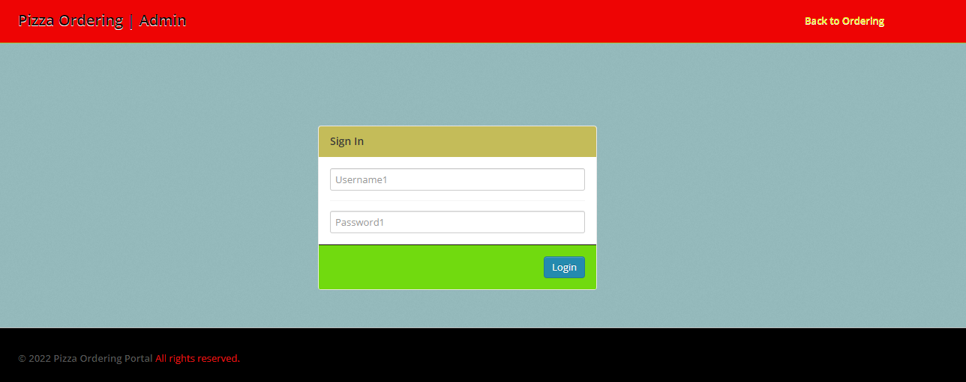
ADMIN LOGIN

Slide 19
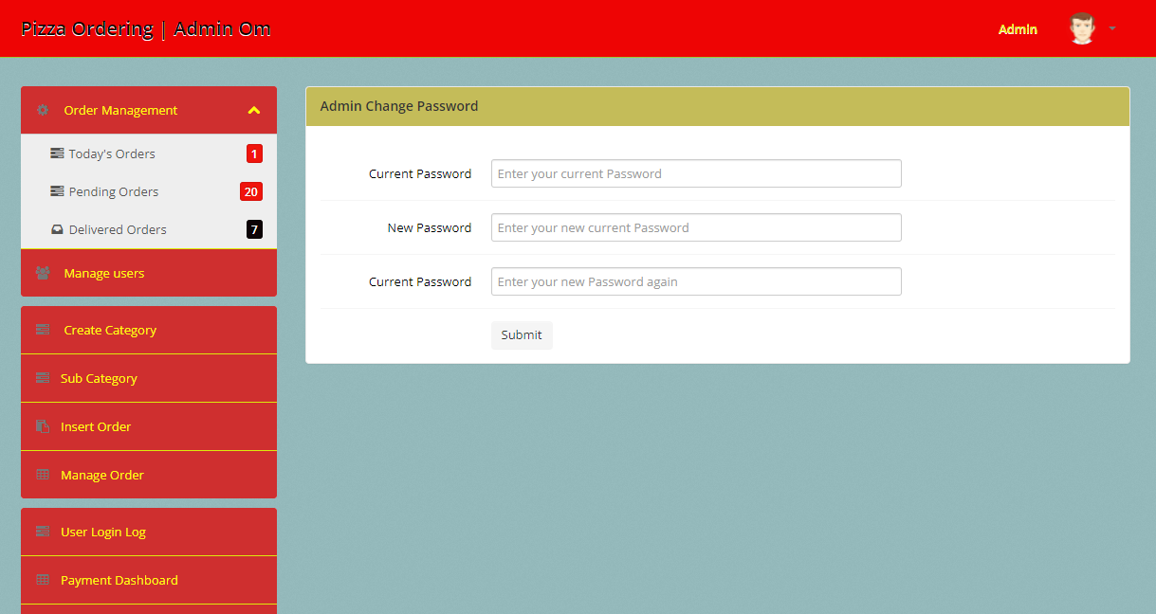
ADMIN DASHBOARD

Slide 20
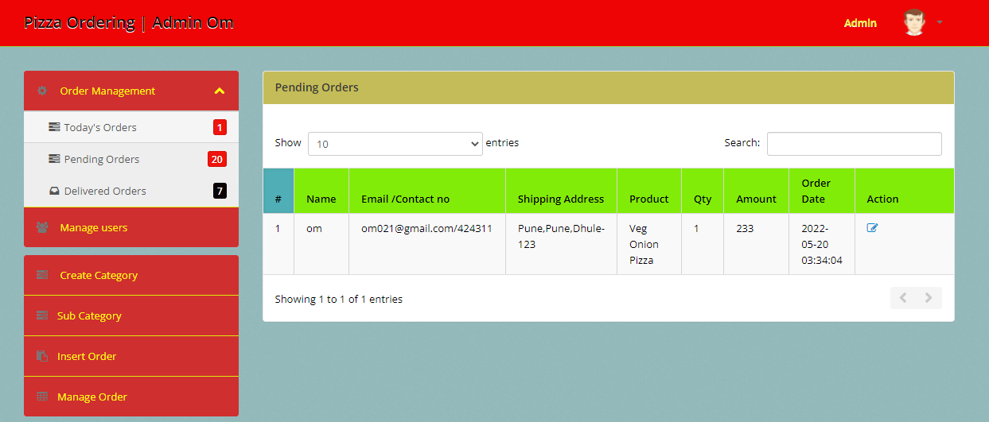
TODAYS ORDER

Slide 21
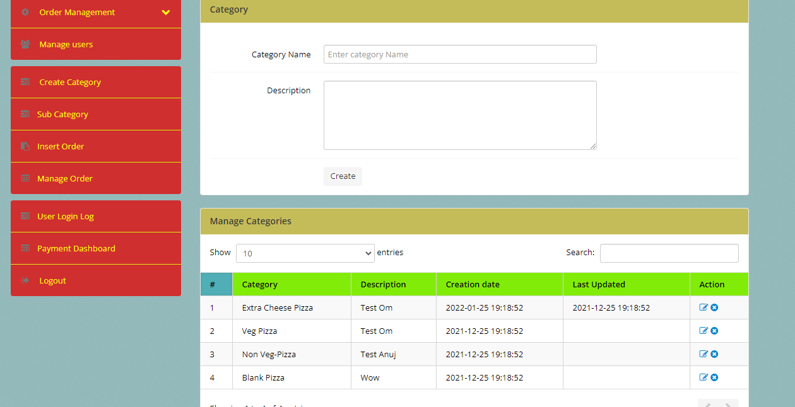
CREATE CATEGORY

Slide 22
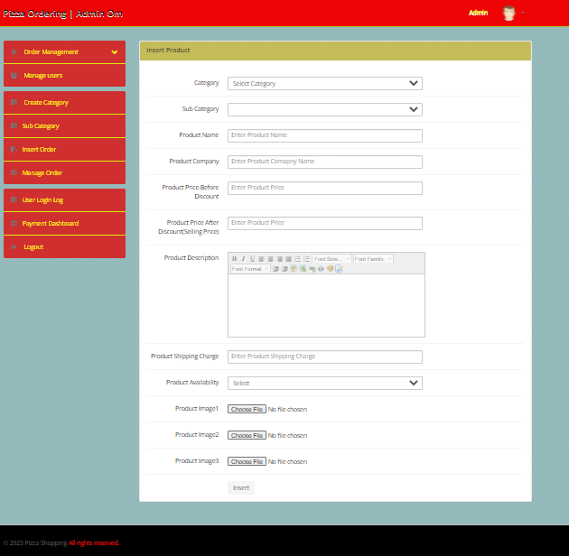
INSERT ORDER

Slide 23
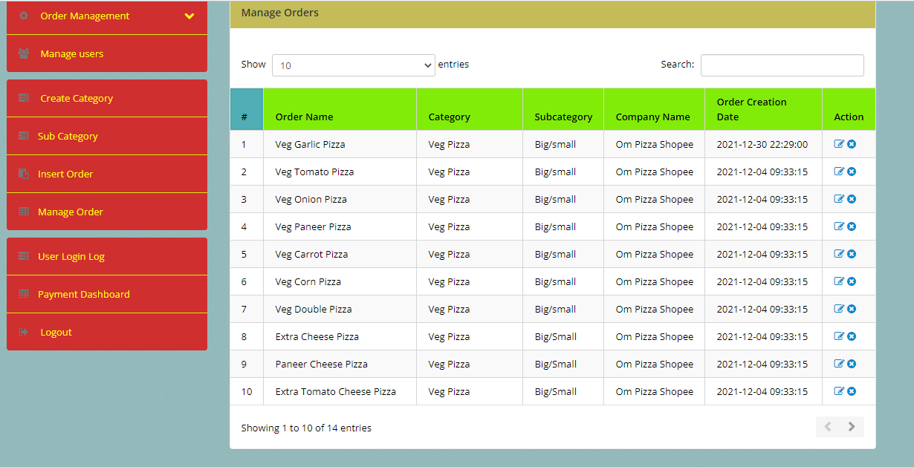
MANAGE ORDER

Slide 24
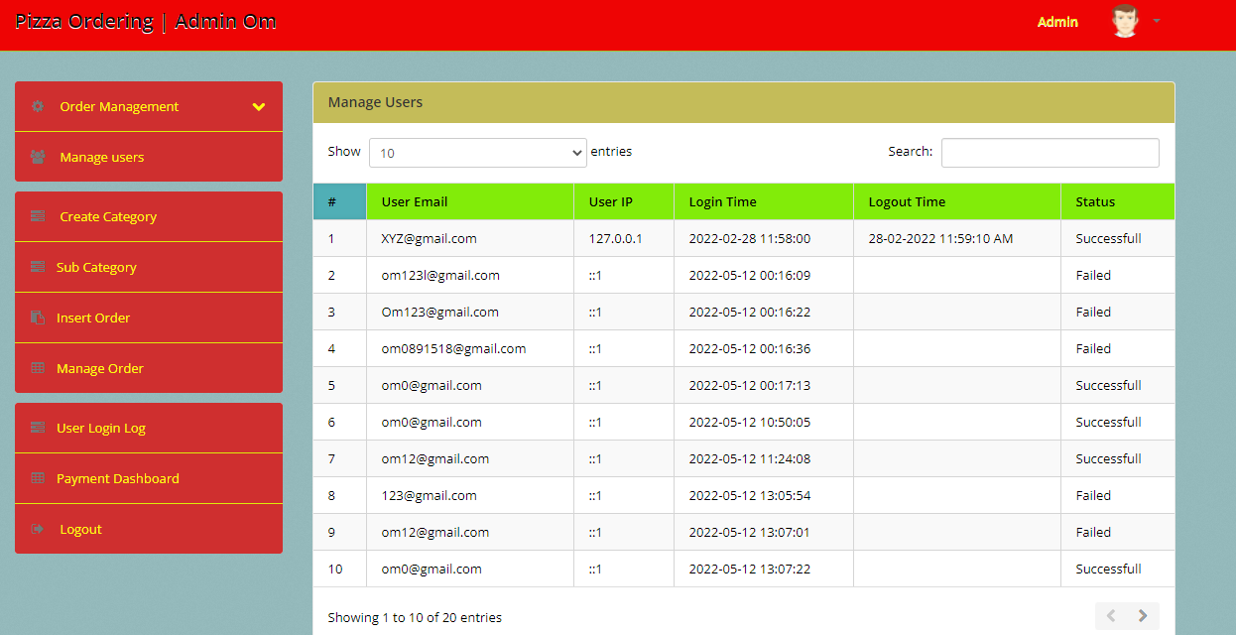
USER LOG -LOGIN

Slide 25
CONCLUSION
So, friends, this was all about the online pizza ordering system. You know the importance of this system in our day-to-day lives as we all prefer online ordering over-ordering on phone. All these modules can be implemented in the web application or a mobile application (Android, iOS, and windows). This project can be developed in any technology or programming language

Slide 26


